Slide 1
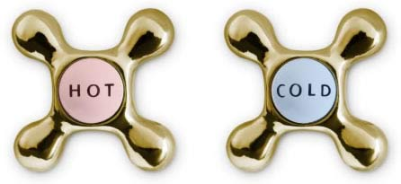
Medical physics –first year
L5-Heat Therapy and Cold in Medicine
Heat and Cold in Medicine
By Assistants professor
Dr. Mohammed Ali Jaber
Physiology Department
College of Medicine
University of Basrah

Slide 2
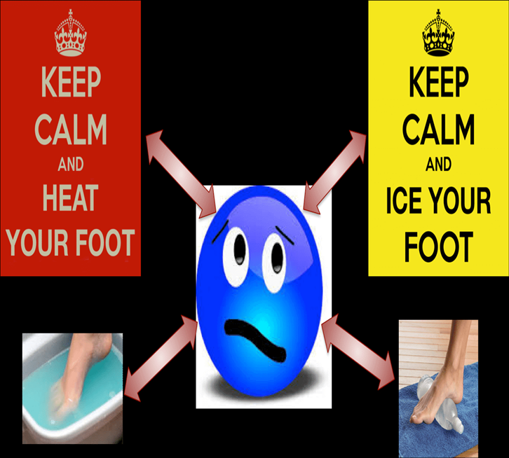
Heat in Medicine
Objectives:
At the end of the lecture the student will be learning
Heat Therapy
The physical methods of producing heat in the body
Use Cold in Medicine(Cryogenics )
Cryotherapy
Cryosurgery

Slide 3
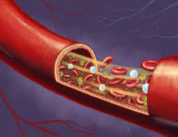
Heat Therapy
Heat therapy works by increasing the temperature around an area of your body that is hurting — such as a muscle. When the body’s temperature rises, it improves blood flow and circulation.
Since it improves blood flow and circulation, it can be an effective way to heal damaged tissues, as well.

Slide 4
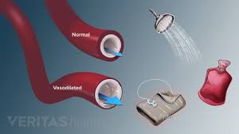
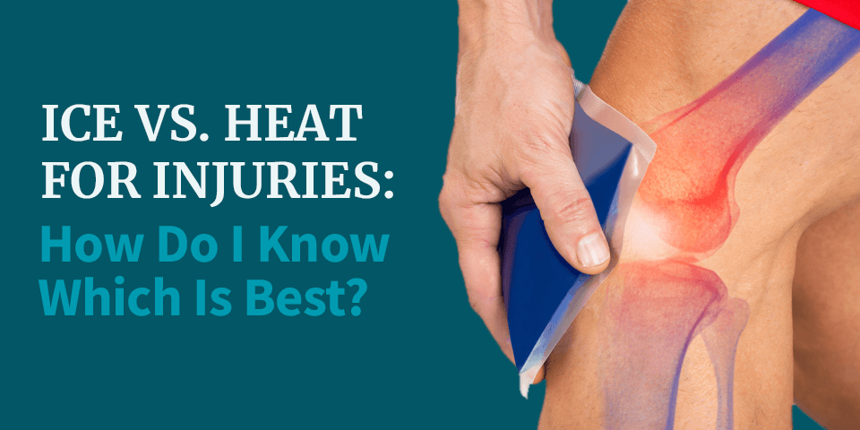
Heat Therapy
Two therapeutic effects take place in a heated area;
Primary : There is an increase in metabolism resulting in a relaxation of the capillary system (vasodilation).
There is an increase in blood flow as blood moves in cool to the heated area.
The relaxation and increased blood flow are beneficial to damage tissue.

Slide 5
The physical methods of producing heat in the body are:
The conducted and convection method
There are two different types of heat therapy: dry heat and moist heat. Both types of heat therapy should aim for “warm” as the ideal temperature instead of “hot.”
Dry heat (or “conducted heat therapy”) includes sources like heating pads, dry heating packs, and even saunas. This heat is easy to apply.
Moist heat (or “convection heat”) includes sources like steamed towels, moist heating packs, or hot baths. Moist heat may be slightly more effective as well as require less application time for the same results.

Slide 6
Heat can transfer by conduction, the quantity of heat transfer depends on:
The temp. difference,
The time of contact,
The area of contact, and
The thermal conductivity of the materials.

Slide 7
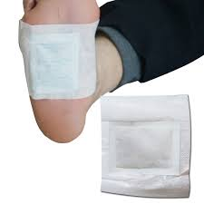
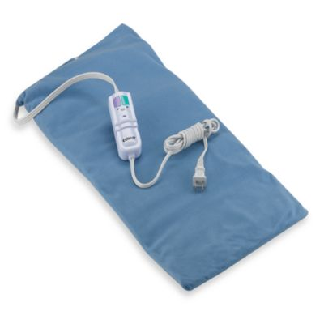
This can be done by several ways such as hot bath, hot packs, and electric heating pad.
This can lead to local surface heating and using in the treatment of arthritis, neuritis, strains, sinusitis and back pain.

Slide 8
2.Radiant (IR) heat
Is used for heating of the body.
Wavelengths used between 800 and 40,000nm.
The wave penetrate the skin about 3mm and increase the surface temperature.
Excessive exposure causes reddening (erythematic) and some times swelling (edema).

Slide 9
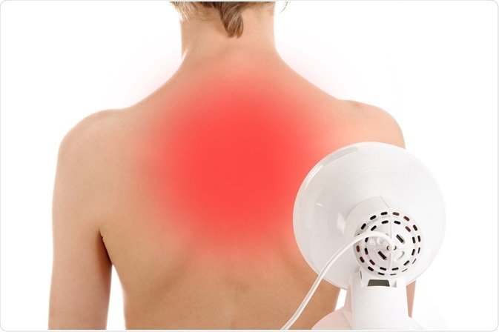
Irradiative heating is generally used for the same conditions as conductive heating , but is considered to be more effective because the heat penetrates deeper.

Slide 10
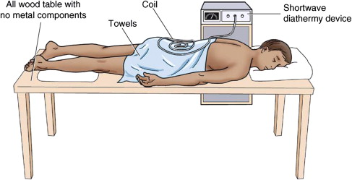
3. Alternating electric current (short-wave diathermy).
Heat from diathermy penetrates deeper into the body than radiant and conductive heat.
It is useful for internal heating and has been used in the treatment of inflammation of skeleton, bursitis(fluid filled sacs) and neuralgia.

Slide 11
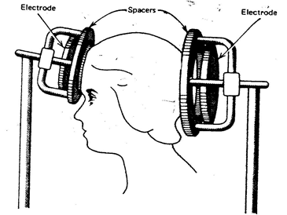
Methods of short wave diathermy
Two different methods are used for transferring the electromagnetic energy into the body in short wave diathermy.
A- In one, the part of the body to be treated is placed between two metal plate-like electrodes energized by the high –frequency voltage.
The body tissue between the plates acts like an electrolytic solution.
Location of capacitor plates for short wave diathermy.

Slide 12
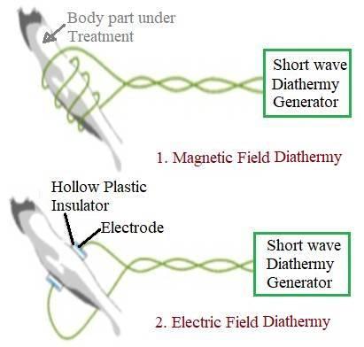
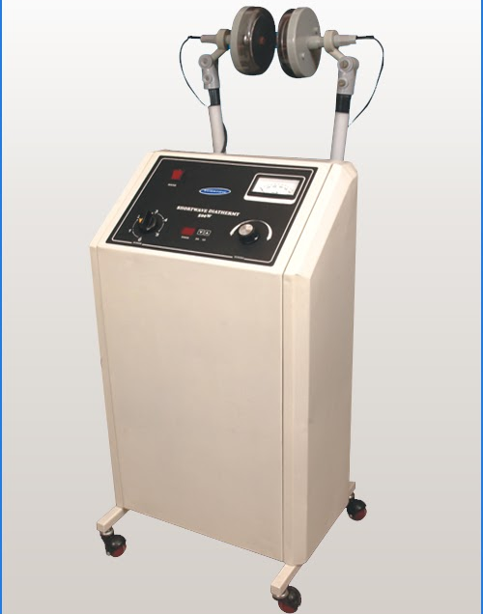
The charged particles are attracted to one plate and the other depending upon the sign of the alternating voltage on the plates.
This results in resistive heating (The resistance to electrical flow that exists in the tissue causes the formation of heat; resulting in an increase in temperature of water in tissue).

Slide 13
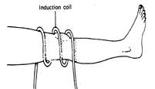
B- The second method of transferring short wave energy into the body is magnetic induction.
A coil is placed around the body region to be treated.
The alternating current in the coil results in an alternating magnetic field in the tissue, producing joule heating in the body region being treated.
Location of induction
coil around knee for
short-wave.

Slide 14
It has been used in:
Relieving muscle spasms,
Pain from protruded intervertebral discs,
Degenerative joint disease, and
Bursitis .

Slide 15
4. Microwave diathermy
The microwaves are produced in a special tube called a magnetron and are then emitted from the applicator (antenna).
The antenna is usually designed so that it can be placed several inches from the region to be treated.
Microwaves from antenna penetrate deep into the tissue, causing a temperature rise and deep heating.
The frequency used in microwave diathermy is 2450 MHz, causing more uniform heating around body region.
Microwave is used in the treatment of fractures, sprains and strains, bursitis, injuries to tendons, and arthritis.

Slide 16
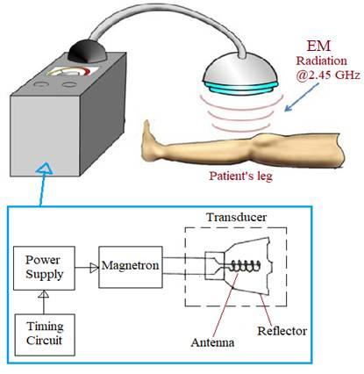
Microwave diathermy

Slide 17
5.Ultrasound waves
Are also used for deep heating of body tissue.
These waves are completely different from electromagnetic waves.
They produce mechanical motion like audible sound waves except the frequency is much higher (usually near 1MHz).
In ultrasonic diathermy, power levels of several watts per square centimeter are usually used and the sound source is directly in contact with the body.
As the ultrasonic wave move through the body the practices in the tissues move back and forth.
The movement is similar to micro massage and results in heating of the tissues.

Slide 18
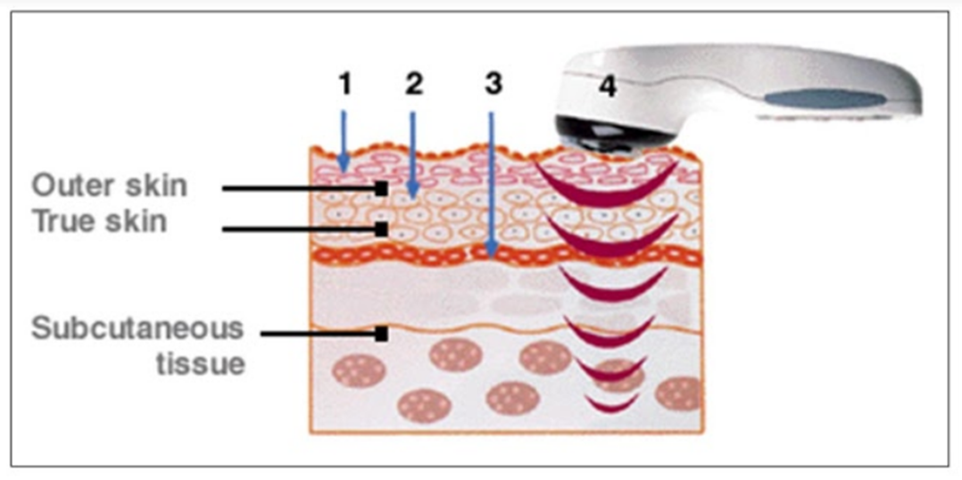
Ultrasonic therapy or ultrasonic diathermy products used in physical therapy equipment produce high-frequency sound waves that travel deep into tissue and create gentle therapeutic heat.
Ultrasonic diathermy is intended to generate deep heat within body tissues for the treatment of selected medical conditions such as pain, muscle spasms and joint contractures.

Slide 19
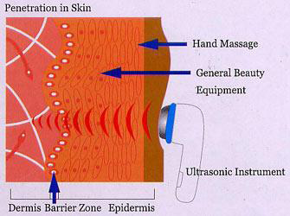
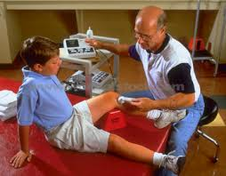
Ultrasonic heating has been found useful in relieving the tightness and scarring that often occur in joint disease.
It greatly aids joints that have limited motion. It useful for depositing heat in the bones because the absorb ultrasound energy more effectively than does soft tissue

Slide 20
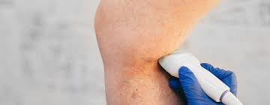
Ultrasound and electromagnetic diathermy (both shortwave and microwave) have useful roles in treating sports injuries. How?
Ultrasound can control inflammation, improve collagen elasticity, and deliver medication to selected tissues.
Electromagnetic diathermy is an alternative to ultrasound for alleviating muscle or joint contractures, muscle spasm, and pain.
Knowing the indications and contraindications of these modalities can help physicians make the best use of these treatment options.

Slide 21
Use Cold in Medicine
Cryogenics

Slide 22
Cryogenics is defined as that branch of physics which deals with the production of very low temperatures and their effect on matter.
The science and technology of temperatures below 120 K.
Gases liquefy. )
In biological matter (water), cryogenic range is below the freezing temperature of water.
It is related to the fact that in biological matter there is a continuity of biophysical processes from 273 K to close to 0 K.
The study of low temperature effects in biology and medicine is called Cryobiology.

Slide 23
Physical Principles
• When ice is applied to the skin, heat is conducted from the skin to the ice in order to melt it.
• To change its state, ice requires considerable energy that is known as latent heat of fusion.
Latent Heat
A specific amount of energy required to change the solid form of a particular substance into a liquid, or the liquid into a gas.
Or is the energy required to change of state.

Slide 24
Cryotherapy
Cryotherapy is a treatment where applied extreme cold to freeze and destroy abnormal tissue. (Cryablation)
During cryotherapy, applies extreme cold to abnormal tissue. Cells can’t survive this severe cold and die after treatment.
This type of treatment removes damaged or diseased tissue that comes from a variety of medical conditions.
Cryotherapy is usually done without open surgery.
Most people recover quickly from the procedure and with little pain.

Slide 25
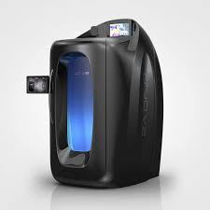
The substances that used in cryotherapy.
Liquid nitrogen.
Liquid nitrous oxide.
Argon gas.
There are different cryotherapy methods to freeze tissue depends on the location of the abnormal tissue.
External: If the tissue is located on skin, use a spraying device or a cotton swab to apply the freezing agent.
Internal: To treat conditions inside the body, like precancerous cells or a tumor, use an instrument called a cryoprobe. This probe is inserted through a small incision (cut) in the skin.
cryotherapy chamber

Slide 26
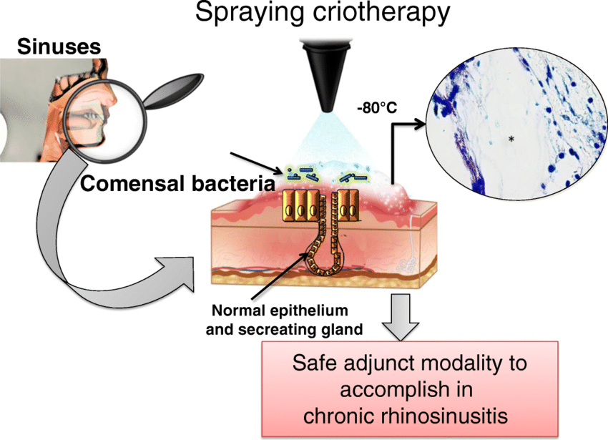
External cryotherapy causes frozen skin to blister and peel off so that healthy new skin can grow. When abnormal cells freeze and die during internal cryotherapy, your immune system helps clear the tissue out of the body.

Slide 27
Cryogenic methods used in medicine
Low temperature have been used for long term preservation of blood, sperm, bone marrow, and tissues.
Studies of their relationship to the hibernation of animals are under way and long term preservation of man being considered.
Bone cancer.
Cervical cancer, liver cancer or prostate cancer.
Precancerous cells in the cervix (lower end of the uterus).
Precancerous skin conditions and early-stage skin cancers, including squamous cell carcinoma and basal cell carcinoma.
Retinoblastoma (cancer of the retina in children).
Skin conditions like warts, skin tags or dark spots.

Slide 28
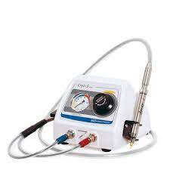
Cryosurgery is a novel technique in which the harmful tissues are destroyed by freezing them to cryogenic temperature.
Cryosurgery has several advantages.
For tumors inside the body, only a small cut or puncture is usually needed to insert the cryoprobe through the skin. As a result, pain, bleeding, and other problems that come with surgery are reduced.
Cryosurgery can often be done with local anesthesia and may not require a hospital stay.
Since cryosurgery is a local treatment and doctors can focus treatment on a precise area, damage to nearby healthy tissue can be reduced.

Slide 29
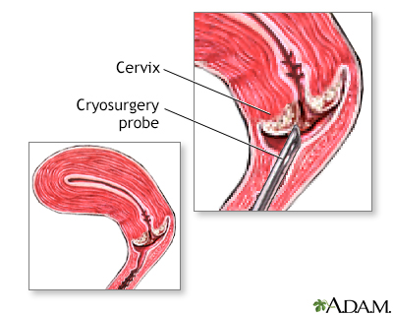
Cryosurgery is a minimally invasive treatment. Compared to traditional surgery, it usually has less pain and bleeding and a lower risk of damaging healthy tissue near the abnormal cells.
The risks of cryotherapy
The risks of cryotherapy are small, but complications can occur. These complications may include:
Bleeding, cramping or pain after cryotherapy around the cervix.
Bone fractures.
Nerve damage resulting in loss of feeling.
Swelling, scarring and skin infection.

Slide 30
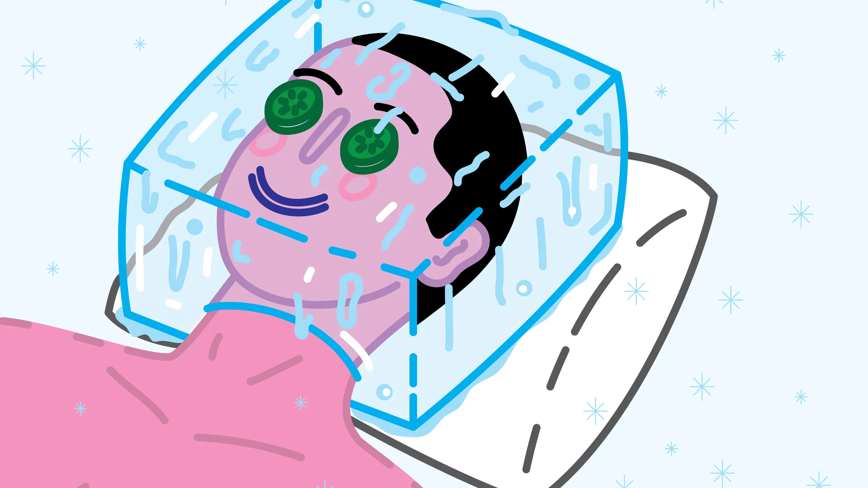
Cryosurgery can be repeated safely and may be used with other cancer treatments.
Cryosurgery may be used when tumors can’t be removed with surgery or when people can’t have surgery because of their age or other medical problems.
Cryosurgery may be an option when the cancer does not respond to standard treatments.
There is little bleeding in the destroyed area.
The volume of tissue destroyed can be controlled by the temperature of the cryosurgical probe.
There is little pain sensation because low temperatures tend to desensitize the nerves.

Slide 31
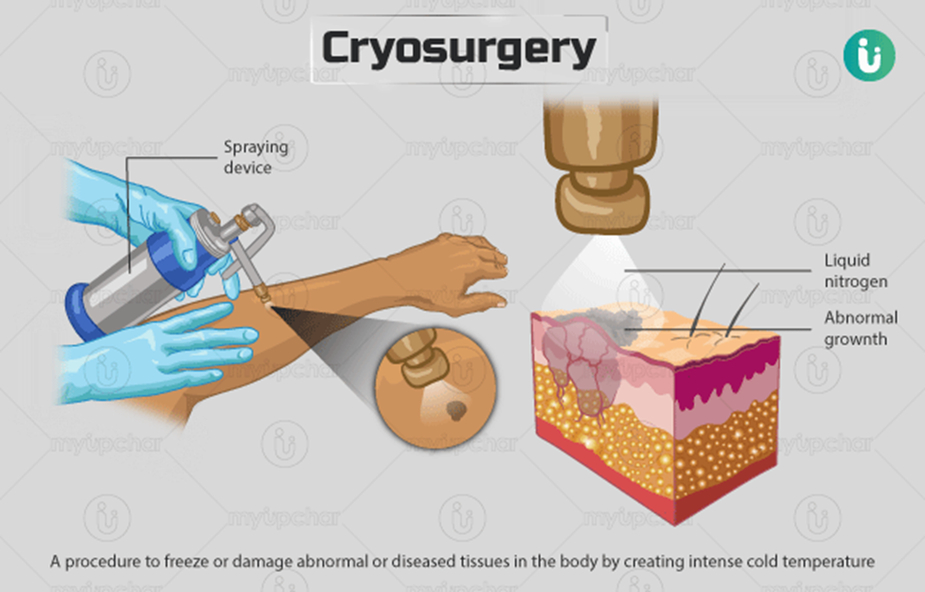

Slide 32
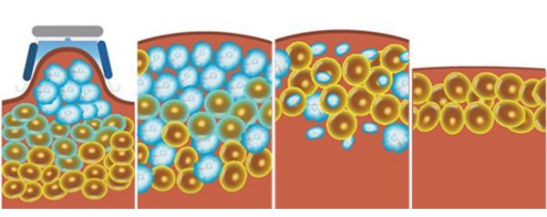
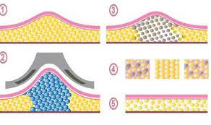
Cryolipolysis device to break up and dissolve fat by cooling

Slide 33
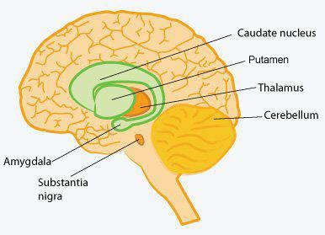
One of uses of cryosurgery was
In the treatment of Parkinson's disease. Parkinson's causes uncontrolled tremors in the arms and legs.
It is possible to stop the tremors by surgically destroying the part of thalamus in the brain that controls the transmission of nerve impulses to other parts of the nervous system.

Slide 34
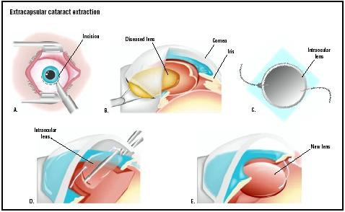
2. One common use of cryosurgery is in the treatment of tumors and warts.
3. Also use to repair of a detached retina and cataract surgery (the removal of a darkened lens).
Perhaps the result of an accident, the retina becomes detached from the wall of eye ball.
This produces a blurred spot in the vision because the light rays are not focused at the correct spot.

Slide 35
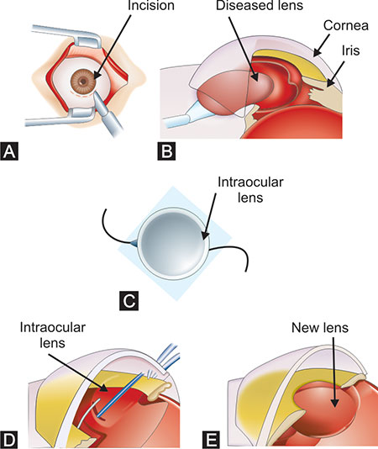
If the cold tip applied to outside of the eye ball in the vicinity of the detachment, a reaction occurs that acts weld the retina to wall of the eyeball.
The technique does not appear to damage the eye. In cryosurgical extraction of the lens, a cold probe is touched to the front surface of the lens. The probe sticks to the lens, making the lens easy to remove.

Slide 36
Thank you

